Slide 1

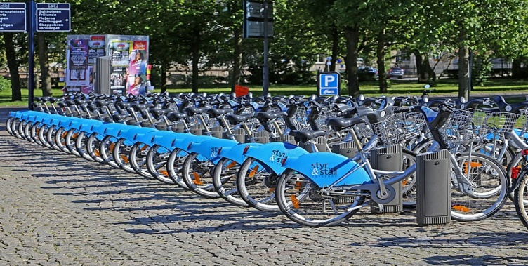
Capstone Project - 2
Seoul Bike Sharing Demand Prediction
Sujit Musale
(Self Project)

Slide 2
About Location and project …….
Seoul is the capital city of south korea .
We are predicting the sharing bike demand for this city.
Data is having various numerical and categorical features.
And we are predict with various model try to get good model.
This is regression based project so, have to find exact value of dependent variable

Slide 3
Problem statement…..
Currently Rental bikes are introduced in many urban cities for the enhancement of mobility comfort. It is important to make the rental bike available and accessible to the public at the right time as it lessens the waiting time. Eventually, providing the city with a stable supply of rental bikes becomes a major concern. The crucial part is the prediction of bike count required at each hour for the stable supply of rental bikes.

Slide 4
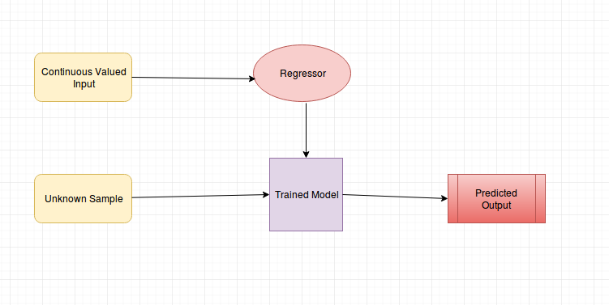
Project (Regression) process flow …..

Slide 5
variable’s Details …..
Date : year-month-day
Rented Bike count - Count of bikes rented at each hour
Hour - Hour of he day
Temperature-Temperature in Celsius
Humidity - %
Wind speed - m/s
Visibility - 10m
Dew point temperature - Celsius
Solar radiation - MJ/m2 (milli Joule per square metre)
Rainfall - mm
Snowfall - cm
Seasons - Winter, Spring, Summer, Autumn
Holiday - Holiday/No holiday
Functional Day – No Func (Non Functional Hours), Fun(Functional hours)

Slide 6
Loading Data & treatment …..
Data set having total-8760 rows and 14 columns
given data set is not having ‘null value’.
It also don’t have any duplicate value.
Also replaced the columns heading as per convenience.
Some treatment done with data column, and month and weakdays and other column added.

Slide 7
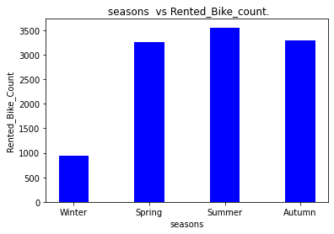
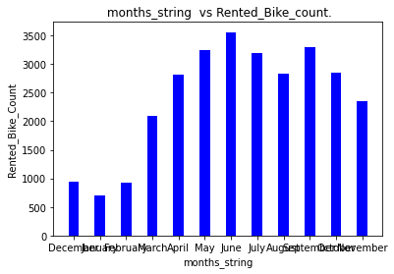
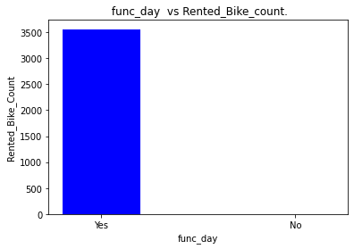
EDA …..
Season vs Rented Bike Count- Summer-> high bike count & winter-> low bike count
Month vs Rented Bike Count- June -> High bike count & Jan -> Low bike count
Func_day vs Rented Bike Count- only for function days people use bike.

Slide 8
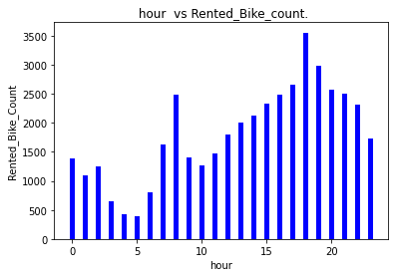
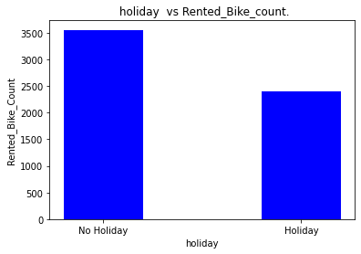
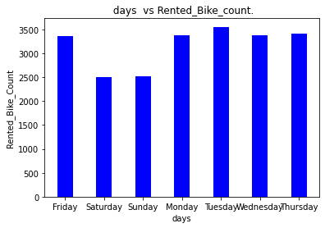
EDA …..
Hour vs Rented Bike Count- high at 6 pm and low at 5 am
Holiday vs Rented Bike Count- Holiday rented bike low.
Days vs Rented Bike Count- Tuesday count is more for rented bike

Slide 9
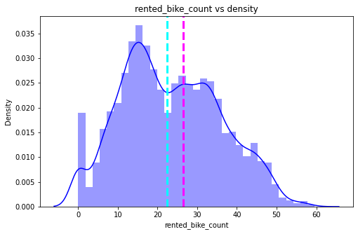
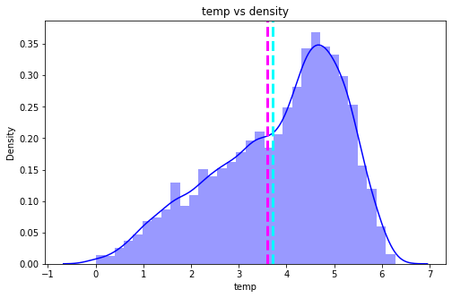
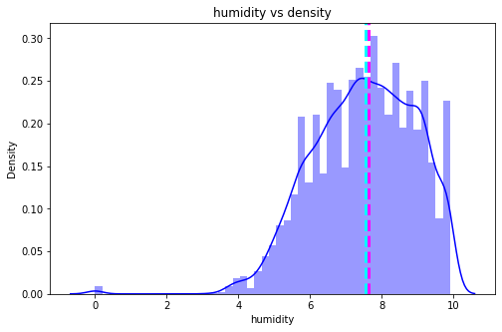
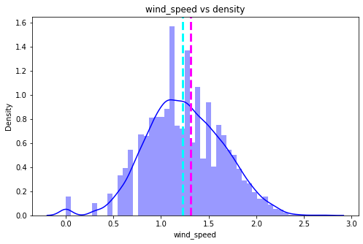
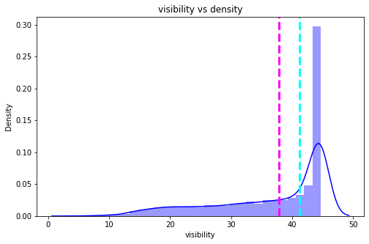
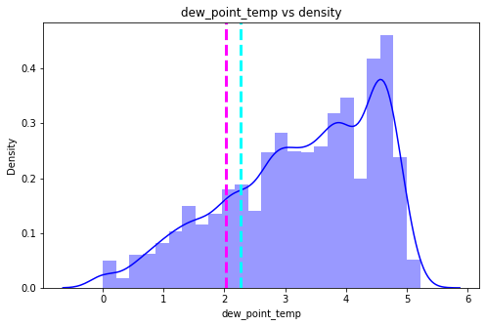
EDA …..
Normalized by Squre root
.

Slide 10
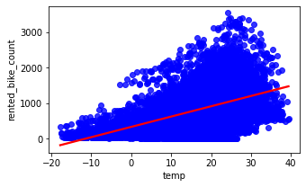
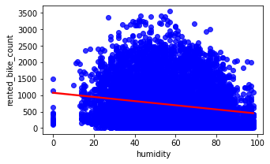
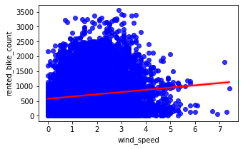
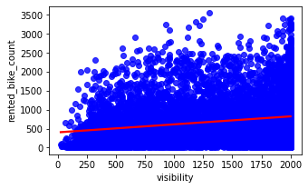
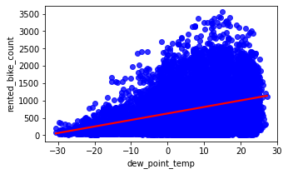
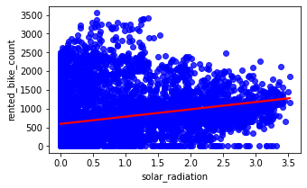
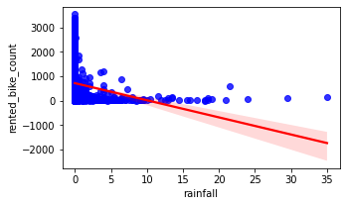
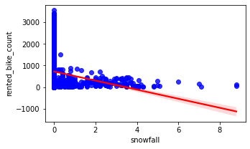
EDA …..
Correlation plot of dependent variable with individual independent variable
.

Slide 11
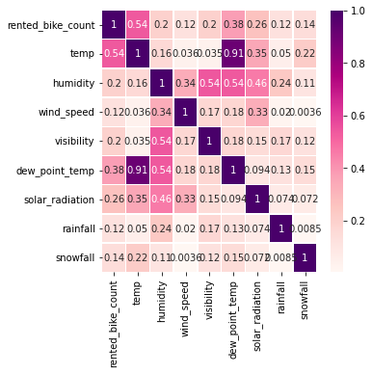
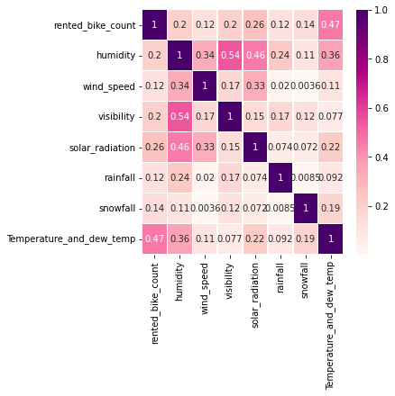
EDA
Over all Correlation plot-
Dew point &
temp are added
To form temperature and
Dev_temp
Before merging After Merging variable
Variable after dumy applied (Total -53 variable) -'rented_bike_count', 'humidity', 'wind_speed', 'visibility', 'solar_radiation', 'rainfall', 'snowfall', 'Temperature_and_dew_temp', 'hour_1', 'hour_2', 'hour_3', 'hour_4', 'hour_5', 'hour_6', 'hour_7', 'hour_8', 'hour_9', 'hour_10', 'hour_11', 'hour_12', 'hour_13', 'hour_14', 'hour_15', 'hour_16', 'hour_17', 'hour_18', 'hour_19', 'hour_20', 'hour_21', 'hour_22', 'hour_23', 'holiday_No Holiday', 'func_day_Yes', 'months_string_August', 'months_string_December', 'months_string_February', 'months_string_January', 'months_string_July', 'months_string_June', 'months_string_March', 'months_string_May', 'months_string_November', 'months_string_October', 'months_string_September', 'seasons_Spring', 'seasons_Summer', 'seasons_Winter', 'days_Monday', 'days_Saturday', 'days_Sunday', 'days_Thursday', 'days_Tuesday', 'days_Wednesday‘

Slide 12
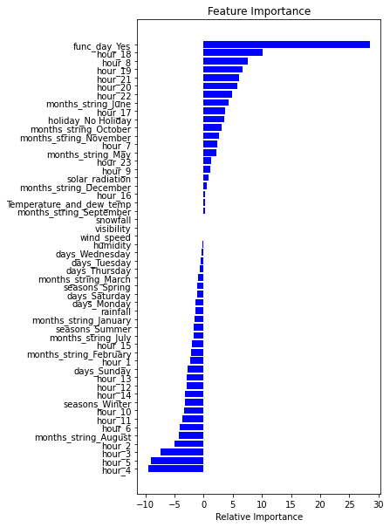
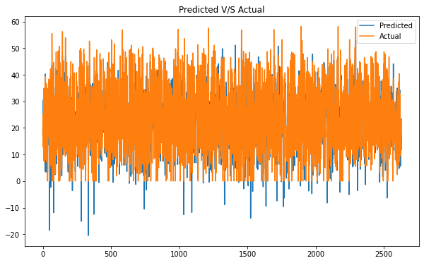
Modeling 1. Linear Regression
Evaluation Matrix | For Train Data | For Test Data
MAE (Mean absolute error) | 4.21 | 4.38
MSE (Mean Squared Error) | 34.62 | 33.02
RMSE(Root Mean Squared Error) | 5.88 | 5.74
R2 score | 0.77 | 0.78

Slide 13

Modeling 2. Ridge Regression
Evaluation Matrix | For Train Data | For Test Data
MAE (Mean absolute error) | 4.42 | 4.38
MSE (Mean Squared Error) | 34.62 | 33.04
RMSE(Root Mean Squared Error) | 5.88 | 5.74
R2 score | 0.77 | 0.78

Slide 14
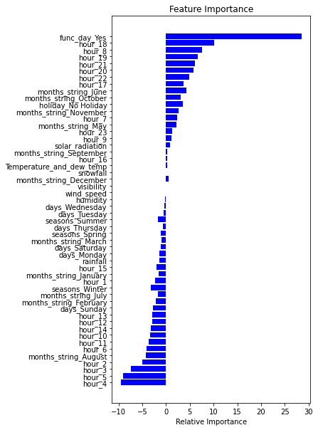
Modeling 3. Lasso Regression
Evaluation Matrix | For Train Data | For Test Data
MAE (Mean absolute error) | 4.42 | 4.38
MSE (Mean Squared Error) | 34.62 | 33.04
RMSE(Root Mean Squared Error) | 5.88 | 5.74
R2 score | 0.77 | 0.78

Slide 15
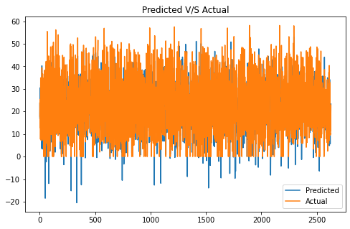
Modeling 4. Decision Tree Regression
Evaluation Matrix | For Train Data | For Test Data
MAE (Mean absolute error) | 4.38 | 4.94
MSE (Mean Squared Error) | 34.86 | 46.8
RMSE(Root Mean Squared Error) | 5.90 | 6.84
R2 score | 0.77 | 0.69

Slide 16
Modeling 5. Random Forest Regression
Evaluation Matrix | For Train Data | For Test Data
MAE (Mean absolute error) | 0.83 | 2.3
MSE (Mean Squared Error) | 1.78 | 13.34
RMSE(Root Mean Squared Error) | 1.33 | 3.65
R2 score | 0.98 | 0.91

Slide 17
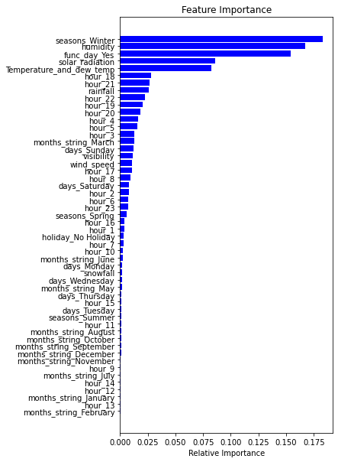
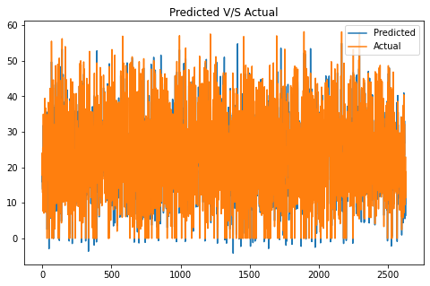
Modeling 6. Gradient Boosting Regressor
Evaluation Matrix | For Train Data | For Test Data
MAE (Mean absolute error) | 1.98 | 2.56
MSE (Mean Squared Error) | 8.21 | 13.79
RMSE(Root Mean Squared Error) | 2.86 | 3.71
R2 score | 0.94 | 0.91

Slide 18
Conclusion
In conclusion, we can say that we implemented various models like Linear Regression, Lasso Regression, Ridge Regression,Decision Tree, Random Forest, Gradient Boosting on the dataset. . Out of all the built model, random forest and gradient boosting hypertuned via GridSearchCV model performed really well for this dataset with r2 score of 98.85% and 91.3% for random forest train and test dataset, for gradient boosting we achieved r2 score of 94.72%, 91.01% respectively.
Although, Linear, lasso ,ridge and Decision Tree has comparatively less r2_score of round 74% for all There were many outliers in the dependent variable which were fixed using square root transformation. The most important features which effect the rented bike count is temperature and dew point temperature.

Slide 19
Thanks

